Slide 1
Making the Case: Slide Deck Template
Communicating Recycling/Composting Program Options with Decision Makers
Notes:
Image Source: FreeImages.com https://www.freeimages.com/download/mother-and-daughter-recycling-1866807

Slide 2
Making the Case for Recycling
The U.S. Environmental Protection Agency provided the Michigan Recycling Coalition (MRC) with a grant to create tools that empower communities to assess recycling and compost program options for an integrated solid waste management system. The Resource Recycling Systems (RRS) developed tool kit includes an accounting guide, a scenario assessment data entry spreadsheet, and a slide deck template.
This slide deck template is meant to assist in messaging recycling and composting options to decision makers – helping to make the case for recycling/composting (establishing or improving programs) in your community.

Slide 3
How to Use this Slide Deck Template
Users are encouraged to copy/paste content into their slide templates (not necessary to attribute to EPA, MRC, or RRS).
Slides may contain items that require input specific to your community – allowing you to customize the presentation to your situation.
Slides may include notes (in the notes section) to help explain the recommended content.
Not all content will be necessary in all situations – use the slides that are applicable to your community.

Slide 4
Current Local Recycling Landscape
Type of Program
# of Households
Participation Rate
Recycling Rate
Cost to Residents to Participate
Community map w/recycling access, MRFs, drop-off sites, etc.
Community Opinion (cost, driving distance, desire to participate)
Notes:
Type of Program (i.e., curbside, drop-off, subscription, etc.)
# of Households (total number of households in community – may or may not include multi-family)
Participation Rate (participating households ÷ total households)
Recycling Rate (amount of MSW recycling/composted ÷ total amount of MSW recycled/composted/landfilled/incinerated)
Cost to Residents to Participate
Image Source: Pexels.com https://www.pexels.com/photo/a-young-girl-and-a-woman-playing-a-kite-together-9035958/

Slide 5
Essential Stakeholders
Residents & Community Representatives
Elected Officials
Haulers/MRFs
End Markets
NGOs & Associations
Finance & Brands
Foundations
Notes:
Identify key players to enable a successful program.
Image source: Pexels https://www.pexels.com/photo/group-of-people-enjoying-music-concert-325521/

Slide 6
Community Goals
Sustainably-funded Program
Support from Essential Stakeholders
Types of Programs & Participants
Benefits & Other Impacts
Recycling Rate
Participation Rate
Emissions Levels
Notes:
Include the goals and timing the community has set. For example: 45% recycling rate by 2025.
Image Source: Pixabay.com https://pixabay.com/photos/beautiful-british-columbia-canada-2297215/

Slide 7
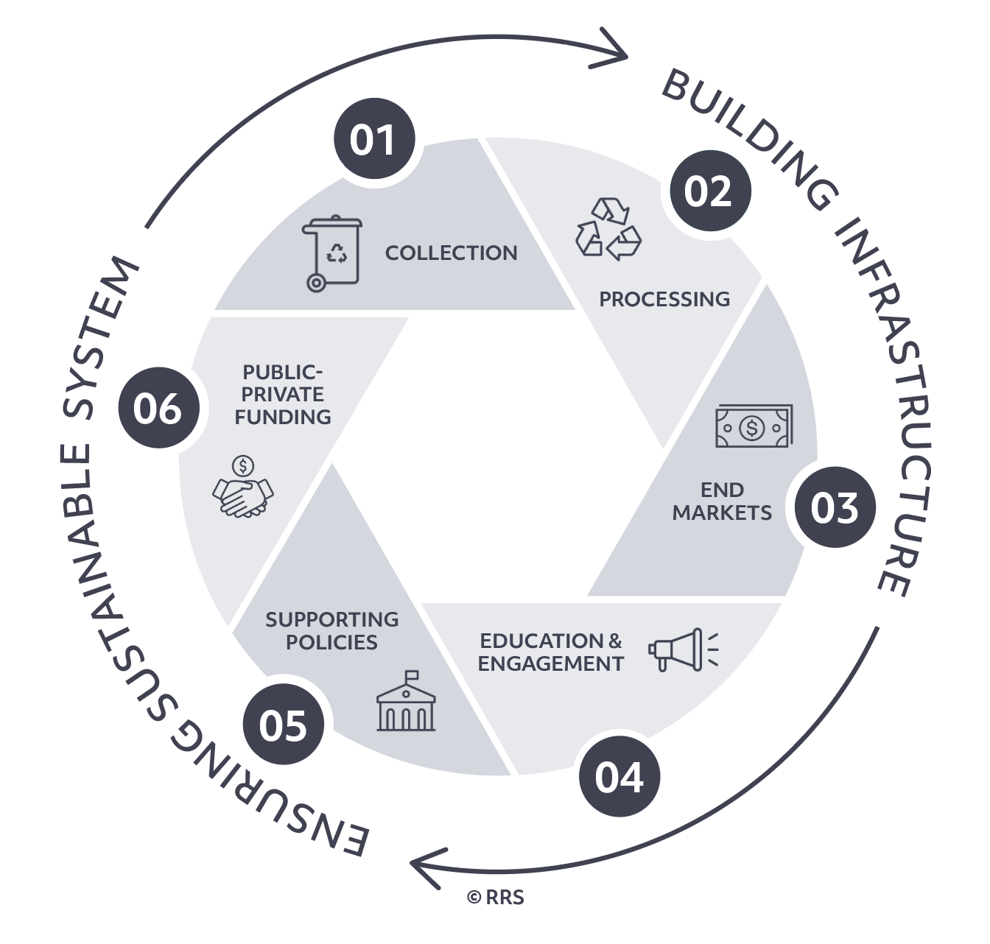
6 Components of a Successful Recovery System
Notes:
All 6 elements support the development and improvement of a successful recovery system thereby keeping value in communities – adding jobs, lowering emissions, creating cleaner communities, and contributing to the local supply chain.
Collection: curbside, drop-off, subscription, etc. – collection should be consistent, reliable, affordable, and meet the needs of the community (including equitable access to the program)
Processing: type of materials accepted leading to low residuals and high-quality bales
End Markets: ability to sell bales to local end markets creating demand for materials (and thereby a local circular economy)
Education & Engagement: inclusive communications with all residents; ensuring residents understand and participate in program; ensuring decision makers understand value of programs
Supporting Policies: legislation and regulations that reduce the quantity of valuable materials going to landfill and increase participation in material recovery
Pubic-Private Funding: various funding mechanisms to sustainable a program (millage, pay-as-you-throw, tip fees, service fees, general fund, grants, etc.)
Image Source: Resource Recycling Systems Inc. (RRS)

Slide 8
Current Collection
Recommended Collection
Collection
Type of Collection
Operator
Cost
Output
Performance Metrics
Essential Stakeholders
Type of Collection
Operator
Cost
Output
Performance Metrics
Essential Stakeholders
Notes:
Work with the collection vendor to understand contracts and metrics.
Essential Stakeholders: public/private local haulers

Slide 9
Recommended Processing
Current Processing
Processing
Owner of Facility
Operator of Facility
Cost
Output
Performance Goals
Essential Stakeholders
Owner of Facility
Operator of Facility
Cost
Output
Performance Metrics
Essential Stakeholders
Notes:
Work with the MRF operator to understand contracts and metrics.
Essential stakeholders: MRFs, operators, secondary markets

Slide 10
Recommended End Markets
Current End Markets
End Markets
Material / End Market (company)
Essential Stakeholders
Material / End Market (company)
Essential Stakeholders
Notes:
Identify end markets that currently/potentially purchase the materials collected in your community. Work with the MRF operator to understand who is purchasing which materials.
Essential stakeholders: brokers, buyers

Slide 11
Recommended Outreach
Current Outreach
Education & Engagement
Activity / Goal
Essential Stakeholders
Activity / Metric
Essential Stakeholders
Notes:
Activities can include:
Website/webpage
Social Media
Apps
Media Engagement (press release, article, interview, tv segment, etc.)
Community Ambassador/Green Team programs
Community Events/Booths
Surveys
Mailers
Flyers
Magnets
And more!
Essential stakeholders: media, residents, decision makers

Slide 12
Recommended Policies
Current Policies
Supporting Policies
Activity / Goal
Essential Stakeholders
Activity / Metric
Essential Stakeholders
Notes:
Legislation and Regulations that support the program, could include:
EPR
Landfill Ban
Beverage Container Deposit
Essential Stakeholders: elected officials, decision makers

Slide 13
Recommended Funding
Current Funding
Public-Private Funding
Funding Mechanism
Amount Provided
% of Program Cost
Essential Stakeholders
Funding Mechanism
Amount Provided
% of Program Cost
Essential Stakeholders
Notes:
Multiple funding mechanisms may be utilized and should be listed – covering both capital (one-time) and operational (continuous) costs.
Essential stakeholders: finance, brands, foundations

Slide 14
Next Steps
Call to Action
Notes:
Provide a call to action – or outline several steps that are necessary to make this happen
More research/commission a study
Detailed implementation planning
Approval on funding
Or whatever is needed for your specific situation
Image Source: Pixabay.com https://pixabay.com/photos/biking-family-adventure-bicycle-1804439/

